Slide 1
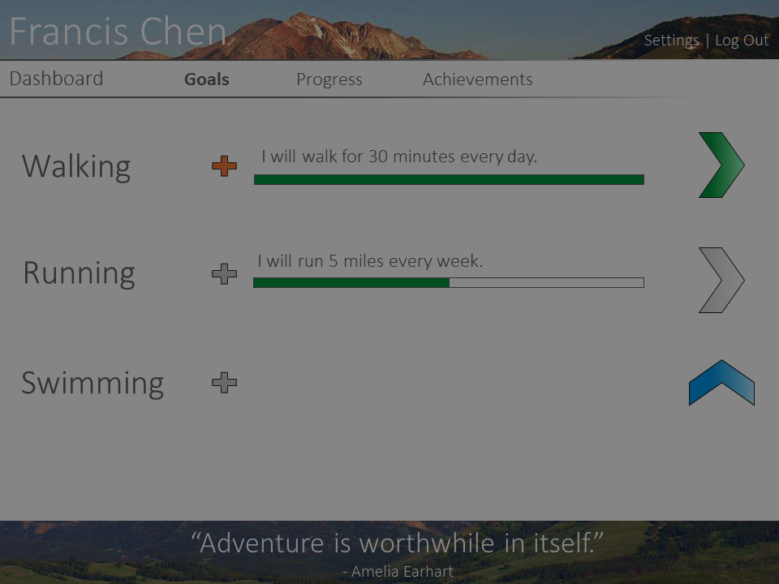
Walking
I will walk for 30 minutes every day.
I will
do this exercise
for
this many
seconds
every
day
.
Add Goal

